Slide 1
Mobile Application Development
Procedural design Method

Slide 2
Procedural design Method
Procedural design method specifies how a task will be performed or how user controls will be manipulated.
It is implemented using java programming language.
This method is recommended for enabling interactivity of android application.

Slide 3
Enabling Interaction
Interactivity allows android application to listen and respond to user events.
This functionality requires the developer to do the following tasks using java programming:
Declare variables for holding references of Input controls
Find references of Input Controls and Initializing reference variables
Event handling – creating event handler and registering it to, event listener

Slide 4
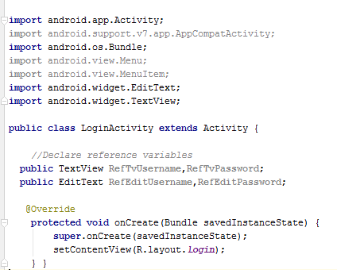
1. Declare Reference variables
The first step is declare variables for holding references of Input controls that are already defined in XML layout file
This is done within activity class but outside oncreate method
Or any other method
Format: ViewType Identifier;
Example:

Slide 5
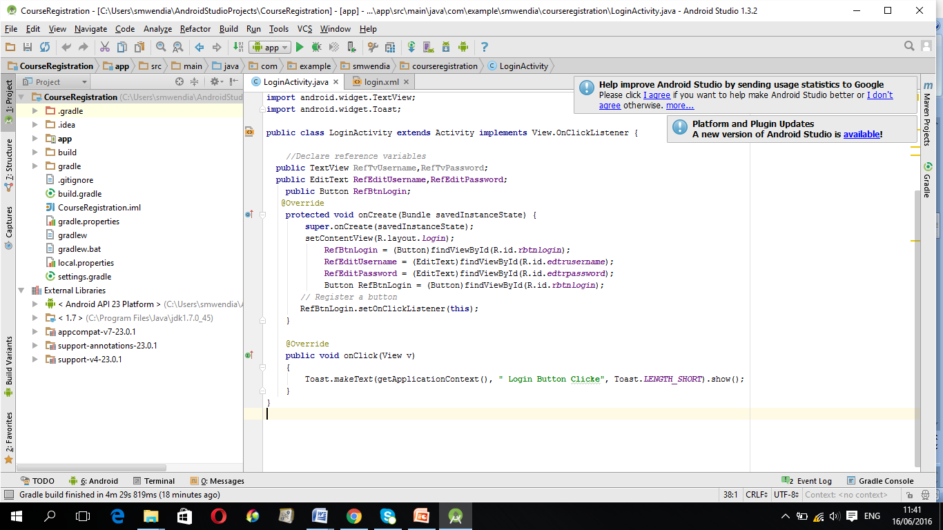
2. Initializing Reference variables
Reference variables are initialized with IDs of an Input controls Done using findViewById() method which is used to fetch Ids of user input controls defined in XML files.
Initialization is implemented within oncreate() method
Format:
Reference variable = findViewById(R.id.idname);
Example:
The following statement retrieves a references of three input controls and assigns the references in reference variables

Slide 6
3. Event handling
Events are actions performed by the user when interacting with the application. e.g. button presses, screen touch etc.
Event handling is the activity of capturing events and take appropriate action as per requirements (e.g. Print a message).
It is a useful way to collect data about a user's interaction with interactive components .
The Android framework maintains an event queue as first-in, first-out (FIFO) basis.

Slide 7
Event Handling concepts
There are three concepts related to Android Event Handling:
1. Event Handler is the method that actually handles a registered event .
2. Event Listener is an interface in the View class that contains a method for calling event handler when an event occurs
3. Event Listeners Registration involves linking an event Listener to a user input control (e.g. a button) so that the event handler will be called when the user performs an action on the control.

Slide 8
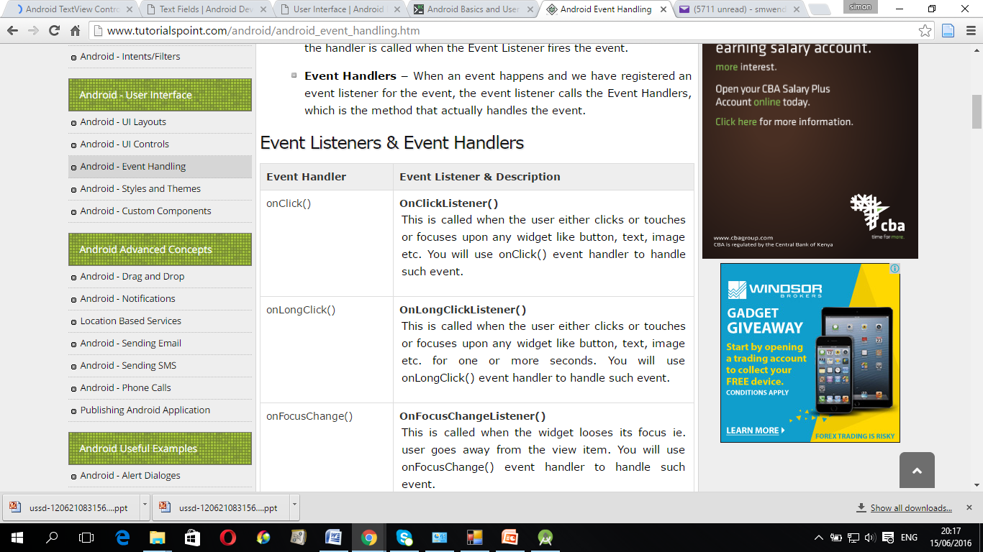
Event Handling concepts
Examples of Event handlers and Event Listeners:

Slide 9
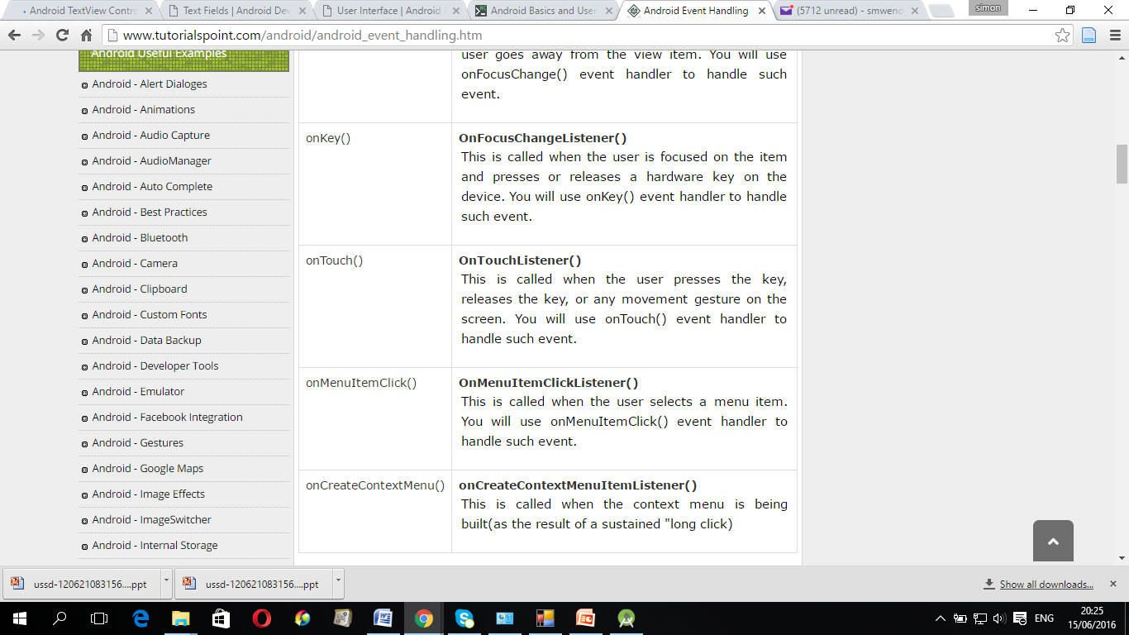
Event Handling concepts
Examples of Event handlers and Event Listeners:

Slide 10
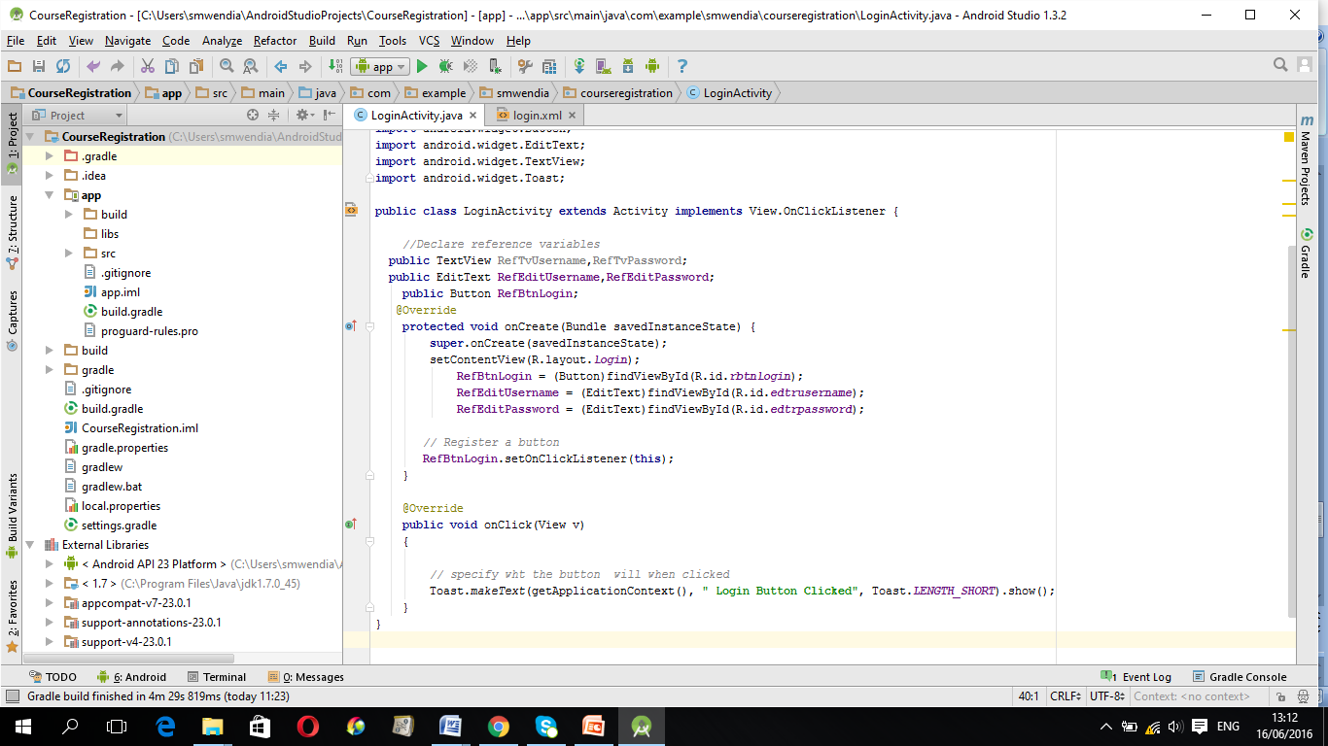
Event Listeners Registration
Event Registration allows event handler to be called when the Event Listener fires the event upon detecting an action from the user or another source.
Format:
Reference variable.eventlistener (current object)
Example: Registering onclick() listener to a Button

Slide 11
Practical Exercise three
Task 1
Modify the Course_Register Application to allow displaying of a message when the user presses login Button.
Task2
Modify event handler method to allow authentication of password and user name.

Slide 12
Task 1
Modify the Course_Register Application to allow displaying of a
message when the user presses login Button.

Slide 13
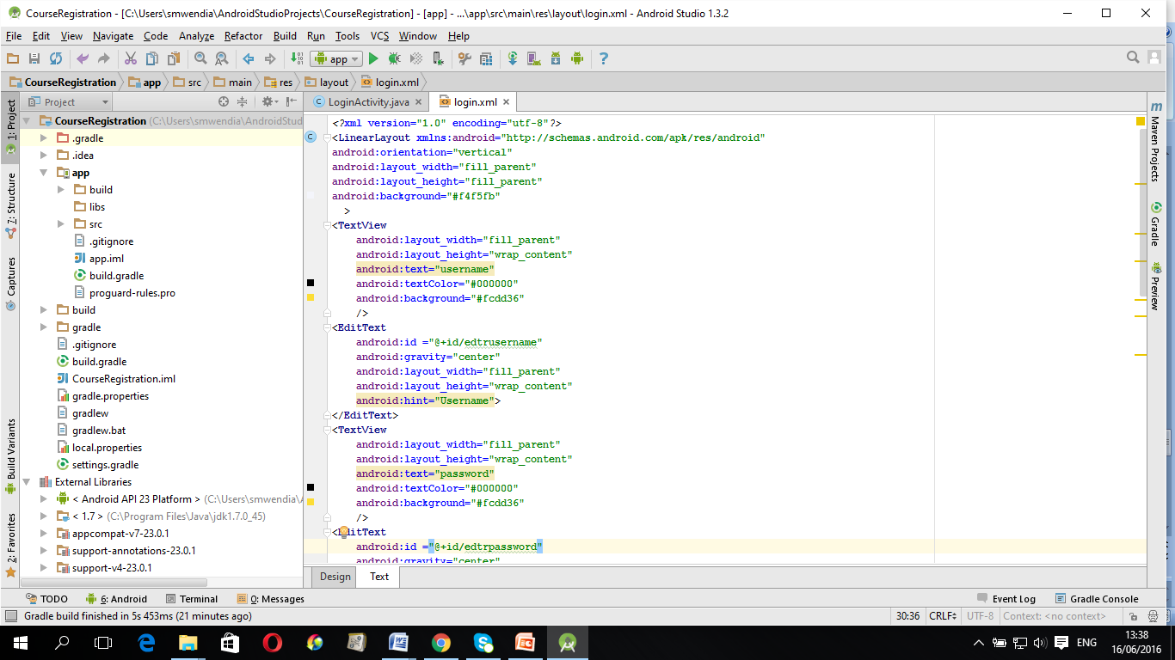
Task 1 : login. xml file

Slide 14
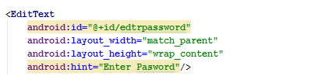
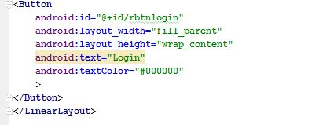
Task 1 : login.xml file

Slide 15
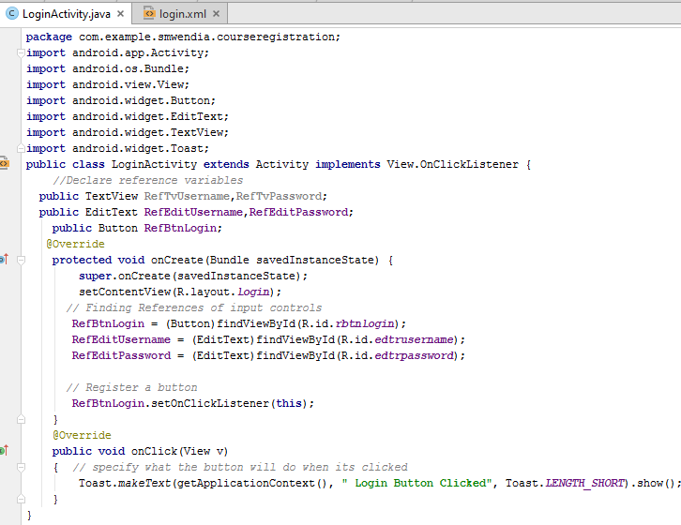
Task 1: LoginActvity.java file

Slide 16
Task2
Modify event handler method to allow authentication of password and user name.

Slide 17
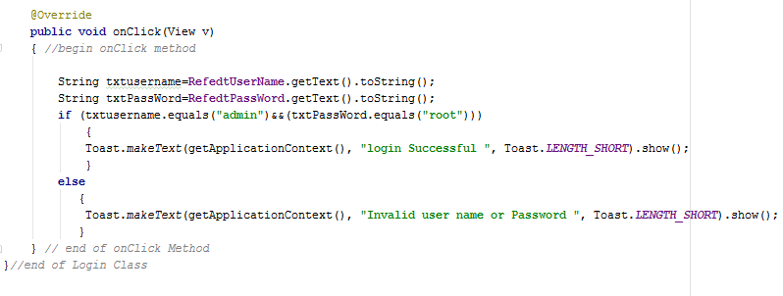
Task2: Authenticating user input
Authentication of user input (e.g. User name and password) is done using decision structures e.g. If/else structure
For Example, The following Java code shows If/else structure in the event handler method. The structure evaluate the two conditions . That is, whether user name == ‘admin’ and password==123
Success message is displayed if both conditions are evaluated true

Slide 18
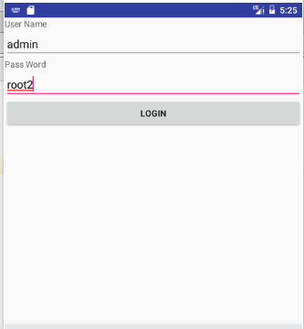
Running Application

Slide 19





